Slide 1

Low Power VLSI Design
By
Dr. Aruru Sai Kumar
Assistant Professor Sr. Grade -2
School of Electronics Engineering (SENSE)

Slide 2
MODULE-4:Low-Voltage Low-Power Adders and Multipliers
Introduction
Standard Adder Cells
CMOS Adder’s Architectures –
Ripple Carry, Carry Look-Ahead, Carry Select, Carry Save Adders
Low-Voltage Low-Power Design Techniques - Trends of Technology and Power Supply Voltage, Low-Voltage Low-Power Logic Styles.
Overview of Multiplication, Types of Multiplier Architectures,
Braun Multiplier,
Baugh-Wooley Multiplier,
Booth Multiplier,
Introduction to Wallace Tree Multiplier.

Slide 3
Outline
Standard Adder Cells.
CMOS Adder’s Architectures
Low-Voltage Low-Power Design Techniques
Overview of Multiplication
Types of Multiplier Architectures

Slide 4
4.1 Introduction
Addition is one of the most fundamental and indispensable arithmetic operations in digital systems, and it plays a crucial role in performing basic computations that form the foundation for many complex mathematical and logical operations used in modern computing systems.
In digital processors, addition is used extensively not only as a standalone operation but also as a key component in implementing other arithmetic functions such as subtraction, multiplication, division, and address calculation in memory systems, making it one of the most frequently executed operations in both general-purpose processors and application-specific integrated circuits.
The adder is widely used in arithmetic logic units (ALUs), digital signal processors (DSPs), and microprocessors, making it a core computational element in many digital architectures.Therefore, the overall performance of these systems is highly influenced by the speed and efficiency of the adder circuits.

Slide 5
Introduction
Therefore, the overall performance of these systems is highly influenced by the speed and efficiency of the adder circuits.
In binary addition, each output bit depends not only on the corresponding input bits but also on the carry generated from the lower-order bit positions.
The carry generated at a lower bit position must propagate toward the higher-order bits before the final sum can be determined.
This carry propagation introduces delay in the circuit, since the carry signal must pass through multiple stages of logic before reaching the most significant bit.
In traditional adder architectures such as the Ripple Carry Adder, the carry signal propagates sequentially from one stage to the next stage.

Slide 6
Introduction
This sequential propagation results in carry propagation delay, which increases linearly as the number of bits in the adder increases.
As the processor word length increases, this delay becomes more significant, making the adder a critical component that determines the overall speed of the digital system.
Earlier, adder design mainly focused on improving speed by reducing carry propagation delay and increasing computational throughput.
With advancements in semiconductor technology and the growth of portable devices, the focus has shifted toward low-power and low-voltage operation while maintaining good performance.

Slide 7
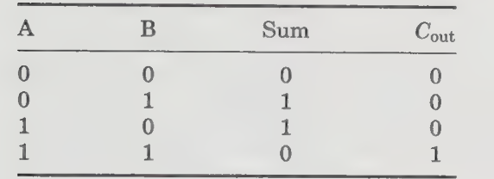
4.2 Standard Adder Cells
Half adders :
The HA is the simplest and most fundamental kind of adder.
It consists of two binary operands that have a pair of single-bits as inputs. and produces a two-bit binary number as its resultant.
The lower order bit of the resultant is known as Sum, whereas the higher order bit is named C_{out}.

Slide 8
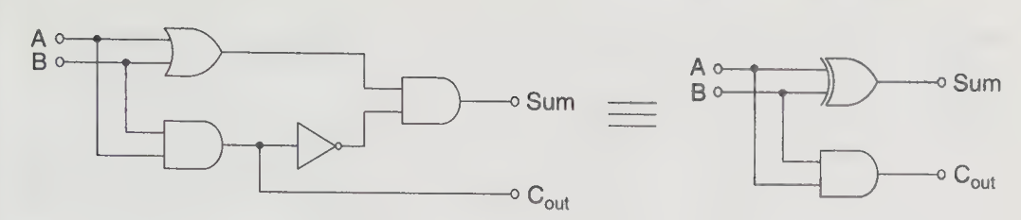
Standard Adder Cells
Half adders :
The logic functions for the Sum and C_{out} are generalized as :
Sum = A ⊕ B
Cout = A.B
Figure 1: Logic gate of a half adder.
The HA can only be used to add two single-bit binary numbers since it does not permit a carry-in.

Slide 9
Standard Adder Cells
To add operands that process more than one bit, the adder would have to have three inputs rather than two, which would enable it to process the carry-in. An adder with a carry-in is called a full adder.
Full adders :
A full adder adds two binary numbers with a carry-in.
It is constructed using two HAs and an OR gate. There are a total of three inputs for the FA, two for the input numbers A and B, and for the carry-in(C_{in}). The outputs are the Sum and carry-out (C_{out}).
The logic functions corresponding to terminals Sum and C_{out} are as follows:
Sum = A ⊕ B ⊕ C
C_{out} = (A ⊕ B) . C_{in} + A.B

Slide 10
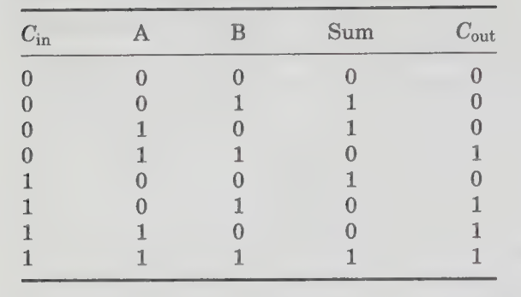
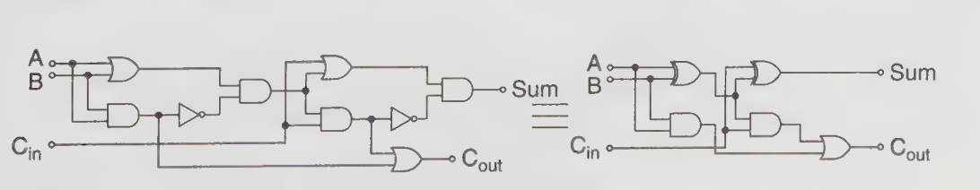
Standard Adder Cells
Figure 2: Logic circuit of the conventional CMOS full adder

Slide 11
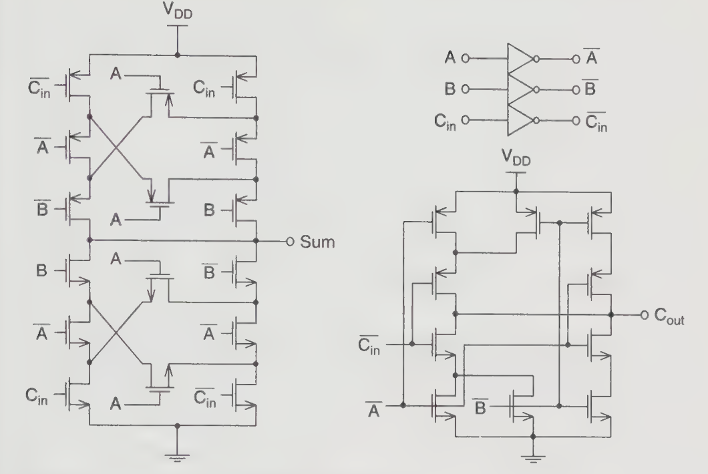
Figure 3: The conventional CMOS full adder

Slide 12
4.3 CMOS Adder’s Architectures
1. Ripple Carry Adders (RCA)
The basic unit of a Ripple Carry Adder (RCA) is a full adder.
It can be extended indefinitely to any number by connecting the carry-out of the previous 1-bit FA to the carry-in of the next 1-bit FA.
An n-bit RCA consisting of n single-bit FAs.
The figure that the carry bit ripples through the chain of the cascaded FAs, from a lower bit to the next higher order FA.

Slide 13
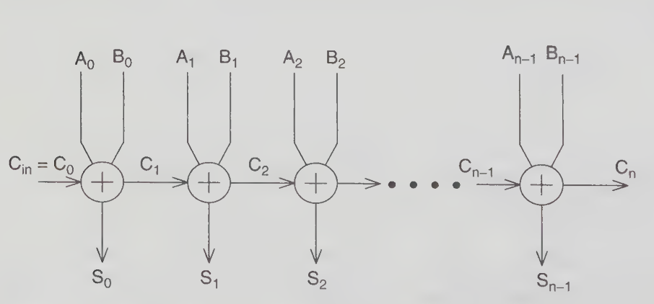
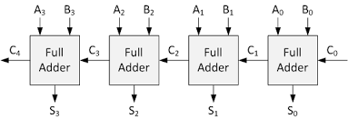
Figure 4: The Ripple Carry Adder (RCA)

Slide 14
CMOS Adder’s Architectures
Performance Evaluation:
Among various adder architectures, the Ripple Carry Adder (RCA) requires the smallest hardware area and provides satisfactory performance when the input data is random.
However, the delay of the RCA is strongly influenced by the length of the carry propagation path, which makes it less suitable for circuits with non-random input operands.
Since all the full adders (FAs) in the RCA are connected through a carry chain, the carry generated at the least significant bit must propagate through each stage until it reaches the most significant bit in the worst-case condition.
As a result, the worst-case delay increases linearly with the number of bits in the operands, denoted by n, because the carry must pass through all the adder stages.

Slide 15
CMOS Adder’s Architectures
Performance Evaluation:
When high-speed performance is required, the Ripple Carry Adder (RCA) may not be suitable because its carry propagation delay limits the overall speed of the arithmetic operation.
Although it uses minimal hardware, the performance can become inadequate for high-speed applications.
However, the carry propagation speed can be improved to some extent by using faster logic circuit technologies and optimized full adder (FA) designs.

Slide 16
CMOS Adder’s Architectures
Glitching Problem in Ripple Carry Adder (RCA):
The Ripple Carry Adder suffers from a glitching problem due to the delay in carry propagation along the chain of cascaded full adders.
Consider a 4-bit RCA, where inputs A_{i} = 0, while B_{i} and the carry input Cin change from 0 to 1.
Ideally, the sum outputs S_{i} should remain 0, because adding 0 and 1 with carry conditions should not immediately produce a final stable output.
However, because the carry signal propagates sequentially through each full adder, each stage experiences a delay before the correct carry arrives.

Slide 17
CMOS Adder’s Architectures
Glitching Problem in Ripple Carry Adder (RCA):
During this delay, the sum outputs temporarily switch between 0 and 1, producing unwanted transitions called glitches.
These spurious switching activities increase dynamic power consumption, which may contribute significantly to the total power dissipation of the circuit.
The glitching effect can be reduced through careful circuit design, optimized full adder structures, and improved adder architectures.

Slide 18
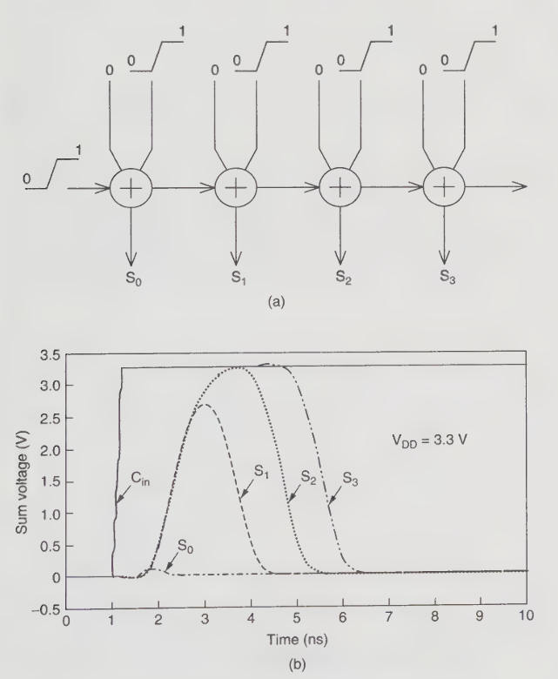
Figure (a) The 4-bit RCA. (6) Static simulation of the 4-bit RCA.

Slide 19
CMOS Adder’s Architectures
Advantages of RCA:
Simple Design
The RCA has a very straightforward structure. It is built by connecting several full adders in series, making it easy to understand and implement.
Easy to Implement
Because of its simple architecture, the RCA is easy to design using basic logic gates or HDL languages such as Verilog/VHDL.
Low Hardware Requirement
It uses fewer logic gates compared to faster adders like Carry Lookahead Adder (CLA) or Carry Select Adder, which reduces hardware complexity.

Slide 20
CMOS Adder’s Architectures
Advantages of RCA:
Low Power Consumption
Due to fewer gates and simpler circuitry, RCA generally consumes less power, which can be useful in small or low-power designs.
Area Efficient
The circuit occupies less silicon area in VLSI implementations, making it suitable for compact designs.

Slide 21
CMOS Adder’s Architectures
Disadvantages of RCA:
Slow Speed (High Propagation Delay)
The major drawback of RCA is that the carry must propagate through every full adder stage before the final sum is produced.
For an n-bit adder, the delay is proportional to n.
Not Suitable for High-Speed Systems
In large-bit adders (16-bit, 32-bit, 64-bit), the carry propagation delay becomes significant, making RCA unsuitable for high-performance processors and DSP systems.
Delay Increases with Number of Bits
As the number of bits increases, the total delay increases linearly, which limits scalability.

Slide 22
CMOS Adder’s Architectures
Disadvantages of RCA:
Performance Limitation in Large Arithmetic Units
Because of the ripple effect of the carry, RCA cannot compete with advanced adders like Carry Lookahead, Carry Skip, or Carry Save Adders used in modern processors.

Slide 23
CMOS Adder’s Architectures
2. Carry Look-Ahead Adders (CLA)
In a Ripple Carry Adder (RCA), the carry must propagate sequentially from one stage to the next, causing the delay to increase linearly with the number of bits (n).
This delay can be reduced by generating carry signals in parallel instead of sequentially, which is the main idea behind the Carry Look-Ahead Adder (CLA).
In the CLA architecture, carry signals are generated simultaneously using look-ahead logic based on propagate (P) and generate (G) signals.
Due to this parallel carry computation, the delay of the CLA grows logarithmically with the number of bits, approximately O(log n), which significantly reduces the carry propagation delay.
However, this improvement in speed comes at the cost of increased hardware complexity, since CLA requires a larger number of logic gates, resulting in higher area and power consumption.

Slide 24
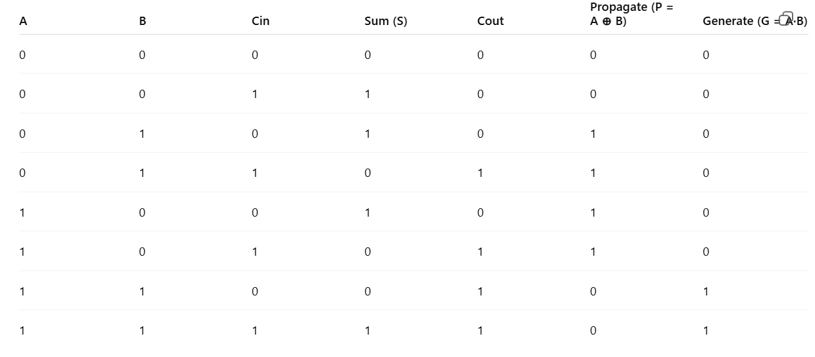
CMOS Adder’s Architectures
Carry Look-Ahead Adders (CLA)
For small adders (≤ 4 bits), the Ripple Carry Adder is often preferred because it requires less hardware and provides comparable speed.

Slide 25
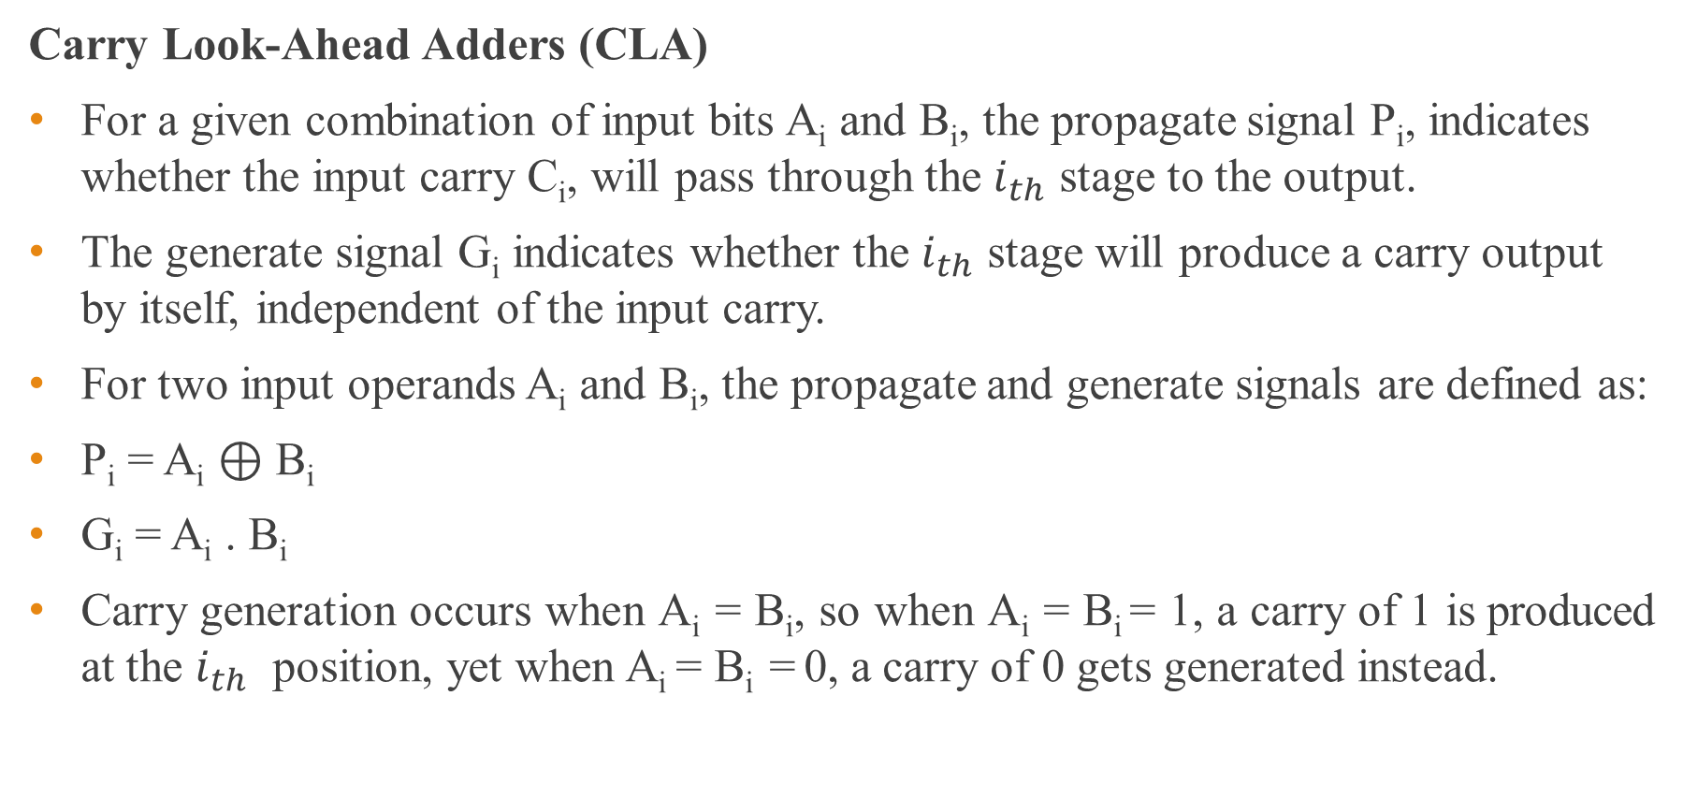
CMOS Adder’s Architectures
Carry Look-Ahead Adders (CLA)
For a given combination of input bits A_{i} and B_{i}, the propagate signal P_{i}, indicates whether the input carry C_{i}, will pass through the $i_{th}$ stage to the output.
The generate signal G_{i} indicates whether the $i_{th}$ stage will produce a carry output by itself, independent of the input carry.
For two input operands A_{i} and B_{i}, the propagate and generate signals are defined as:
P_{i} = A_{i} ⊕ B_{i}
G_{i} = A_{i} . B_{i}
Carry generation occurs when A_{i} = B_{i}, so when A_{i} = B_{i} = 1, a carry of 1 is produced at the $i_{th}$ position, yet when A_{i} = B_{i} = 0, a carry of 0 gets generated instead.

Slide 26
CMOS Adder’s Architectures
Carry Look-Ahead Adders (CLA)
On the other hand, carry propagation occurs when A_{i} != B_{i} .
Besides the P_{i} and G_{i} signals, the Boolean variables for the CLA adder are
Si = P_{i} ⊕ C_{i}
C_{i+1} = G_{i} ⊕ P_{i} . C_{i}
where Si and C_{i+1} are the sum and carry recurrence for the ith stage, respectively.

Slide 27
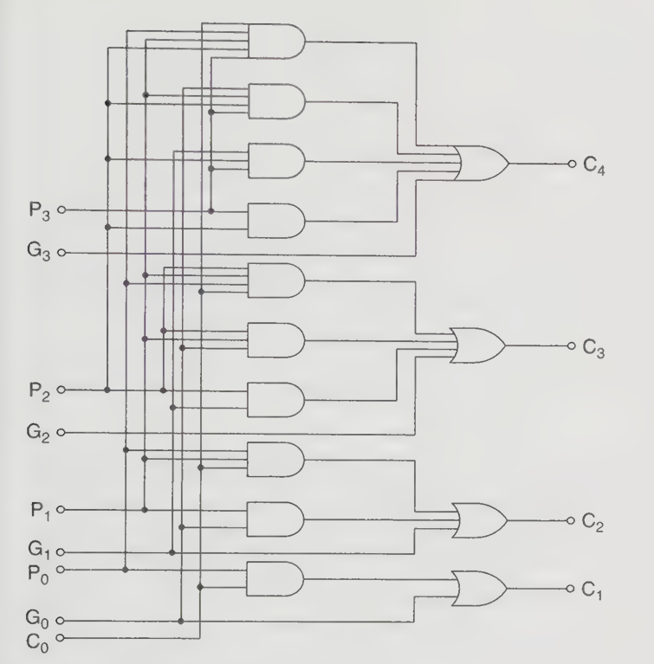
Figure : Logic schematic of 4-bit carry.

Slide 28
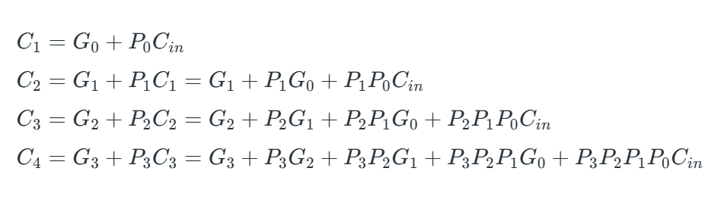

Slide 29
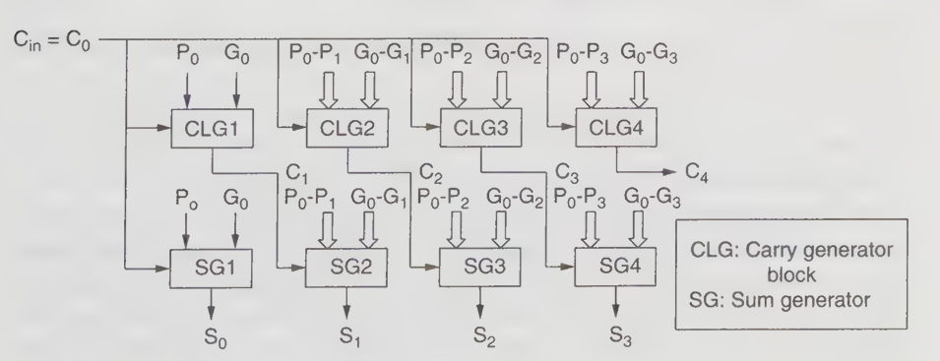
Figure : Block diagram of the 4-bit CLA

Slide 30
CMOS Adder’s Architectures
Carry Look-Ahead Adders (CLA)
The carry generation requires only two gate delays.
This makes the addition of two n-bit operands extremely fast as compared to the RCA.
However, it costs more gates to implement this logic circuit, because for large values of n, a huge number of gates and very big fan-in gates are required.
Therefore, to reduce the span of the carry look-ahead, the n-bit operands are divided into equal-sized groups, which are then interconnected by incorporating the concept of RCA. This method inevitably reduces the speed of carry propagation.

Slide 31

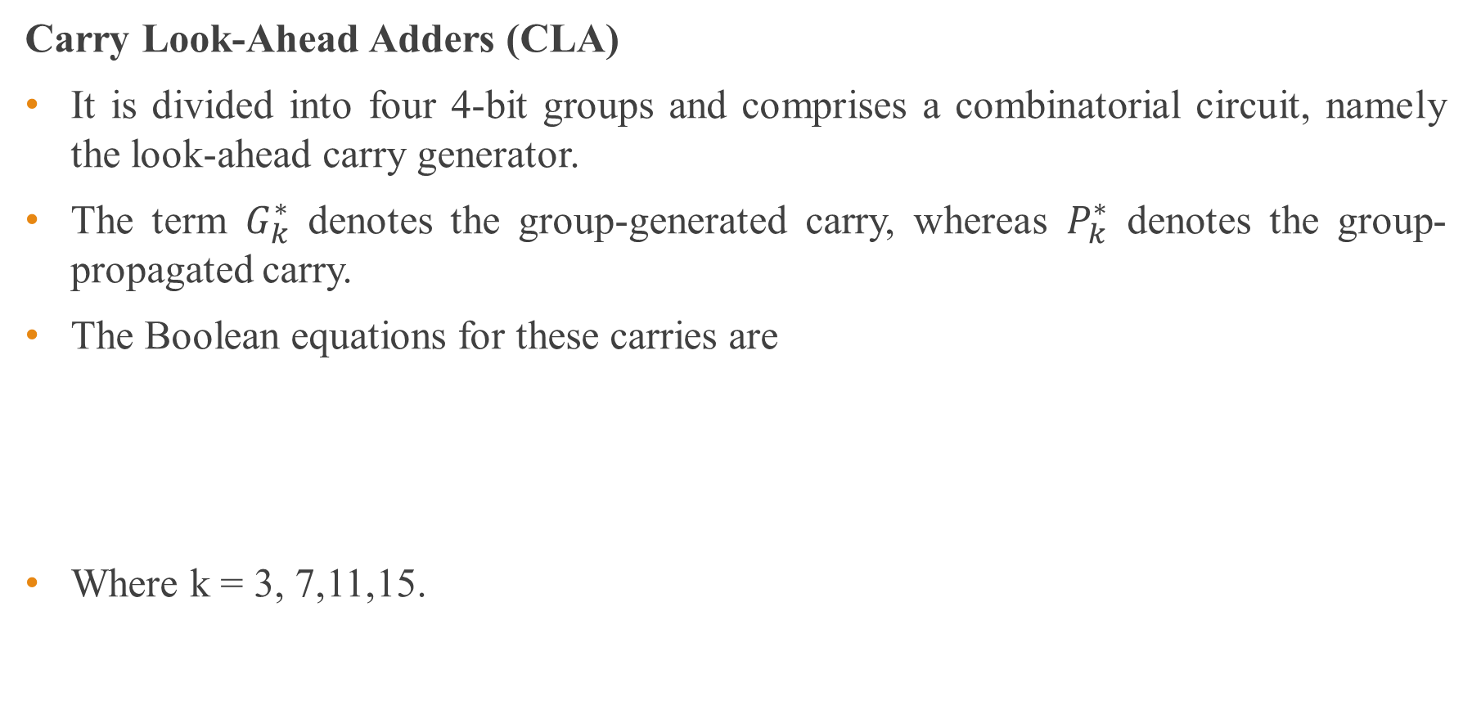
CMOS Adder’s Architectures
Carry Look-Ahead Adders (CLA)
It is divided into four 4-bit groups and comprises a combinatorial circuit, namely the look-ahead carry generator.
The term $G_{k}^{∗}$ denotes the group-generated carry, whereas $P_{k}^{∗}$ denotes the group-propagated carry.
The Boolean equations for these carries are
Where k = 3, 7,11,15.

Slide 32
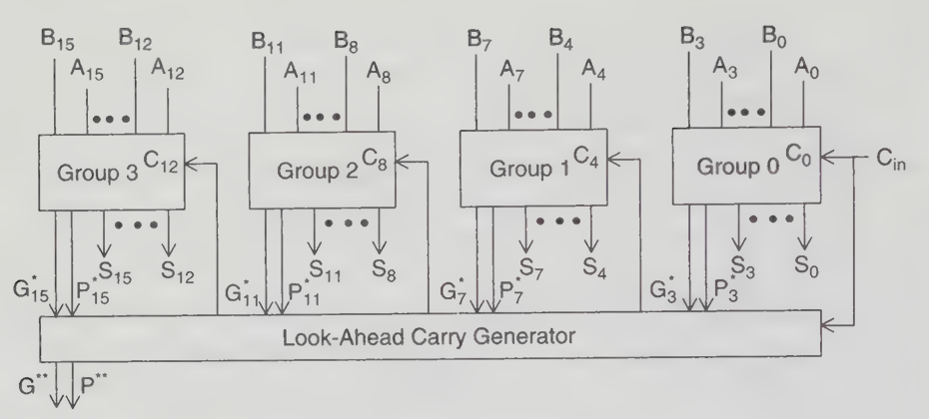
Figure: Block diagram of a 16-bit carry look-ahead adder

Slide 33



CMOS Adder’s Architectures
Carry Look-Ahead Adders (CLA)
The implementation of these equations is carried out by the look- ahead carry generator, where both terms $G_{k}^{∗}$ , and $P_{k}^{∗}$ are used to generate the group carry-ins.
The outputs of the look-ahead carry generator, $C_{4}$, $C_{8}$ , and $C_{12}$ serve as inputs to the subsequent groups.

Slide 34
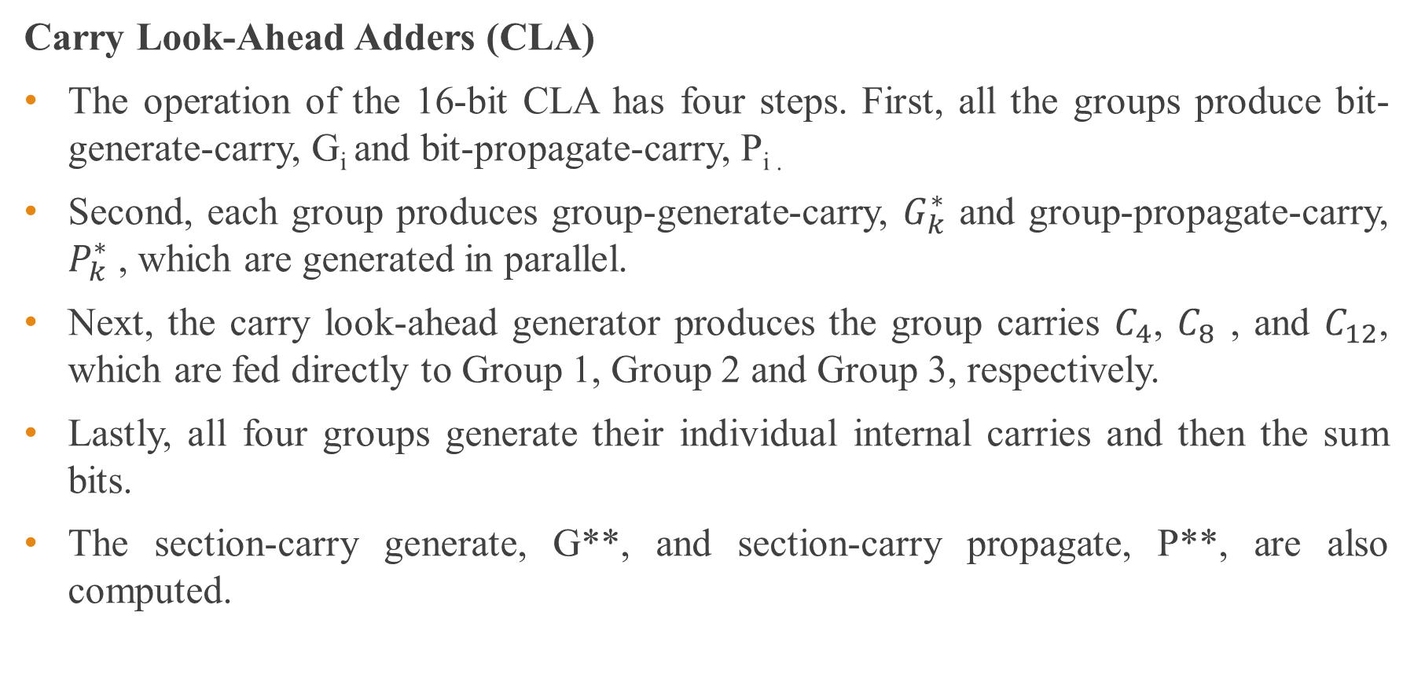
CMOS Adder’s Architectures
Carry Look-Ahead Adders (CLA)
The operation of the 16-bit CLA has four steps. First, all the groups produce bit-generate-carry, G_{i} and bit-propagate-carry, P_{i .}
Second, each group produces group-generate-carry, $G_{k}^{∗}$ and group-propagate-carry, $P_{k}^{∗}$ , which are generated in parallel.
Next, the carry look-ahead generator produces the group carries $C_{4}$, $C_{8}$ , and $C_{12}$, which are fed directly to Group 1, Group 2 and Group 3, respectively.
Lastly, all four groups generate their individual internal carries and then the sum bits.
The section-carry generate, G**, and section-carry propagate, P**, are also computed.

Slide 35
CMOS Adder’s Architectures
Advantages of Carry Look Ahead Adder:
High Speed Operation
The main advantage of a Carry Look Ahead Adder is its very fast addition speed. Unlike the Ripple Carry Adder, it does not wait for the carry to propagate through each stage. Instead, it calculates carries in advance using generate and propagate signals.
Reduced Propagation Delay
CLA significantly reduces the carry propagation delay because all carry signals are computed simultaneously using combinational logic. This improves the overall performance of the adder.
Suitable for Large Bit Adders
Carry Look Ahead Adders are more efficient for large bit-width additions (16-bit, 32-bit, 64-bit, etc.) where ripple carry delay becomes very large.

Slide 36
CMOS Adder’s Architectures
Advantages of Carry Look Ahead Adder:
Improved System Performance
Since addition is a fundamental operation in processors, using CLA improves the overall speed of ALUs and arithmetic circuits in digital systems.
Parallel Carry Computation
The carry signals are generated in parallel rather than sequentially, which allows faster computation compared to Ripple Carry Adders.
Better Scalability for High-Speed Systems
CLA structures can be extended using hierarchical carry look-ahead units, making them suitable for high-performance VLSI systems and microprocessors.

Slide 37
CMOS Adder’s Architectures
Disadvantages of Carry Look Ahead Adder:
Complex Circuit Design
The logic required to generate and propagate carries is more complicated than in a Ripple Carry Adder. This makes the overall circuit more complex to design and implement.
Large Hardware Requirement
CLA requires additional generate (G) and propagate (P) logic circuits and carry computation blocks, which increases the number of logic gates used.
Higher Power Consumption
Because of the increased number of gates and more complex logic, the power consumption is higher compared to simpler adders like Ripple Carry Adders.

Slide 38
CMOS Adder’s Architectures
Disadvantages of Carry Look Ahead Adder:
Larger Area Requirement
The additional logic for carry look-ahead computation increases the silicon area in VLSI implementations.
Not Efficient for Very Large Bit Widths Without Hierarchy
For very large adders (32-bit, 64-bit, etc.), the carry look-ahead logic becomes extremely complex. Therefore, hierarchical structures or multi-level CLA designs are required.
Wiring Complexity
The carry signals must be distributed to multiple stages simultaneously, which leads to complex interconnections and routing difficulties in VLSI layouts.

Slide 39
CMOS Adder’s Architectures
3. Carry Select Adders (CSL)
The Carry Select Adder (CSL provides a substantial compromise between the RCA, which occupies a small area and has a longer delay, and the CLA, which occupies a larger area and has a shorter delay.
In the CSL, both the n-bit operands, A_{i} and B_{i} are divided into k blocks of possibly different sizes.
In 8 bit implementation , the first block with C_{in}, = C_{o} is implemented by a 4-bit adder, typically the RCA, while the second block is evaluated conditionally with a pair of adders, thus permitting two additions to be executed in parallel.
One addition assumes that the carry-in (C_{in}) is zero while the other addition assumes that the C_{in}, is one.

Slide 40
CMOS Adder’s Architectures
Carry Select Adders (CSL)
Accordingly, two sums and two carry-outs get generated. In order to select the correct set of sum bits (S₄₋₇) and the carry-in for the next block (C₈) from the respective multiplexers, a control signal, C₄, which is computed from the preceding block is required.
The additional cost of the CSL over the RCA is the duplicate carry chain and the select logic

Slide 41
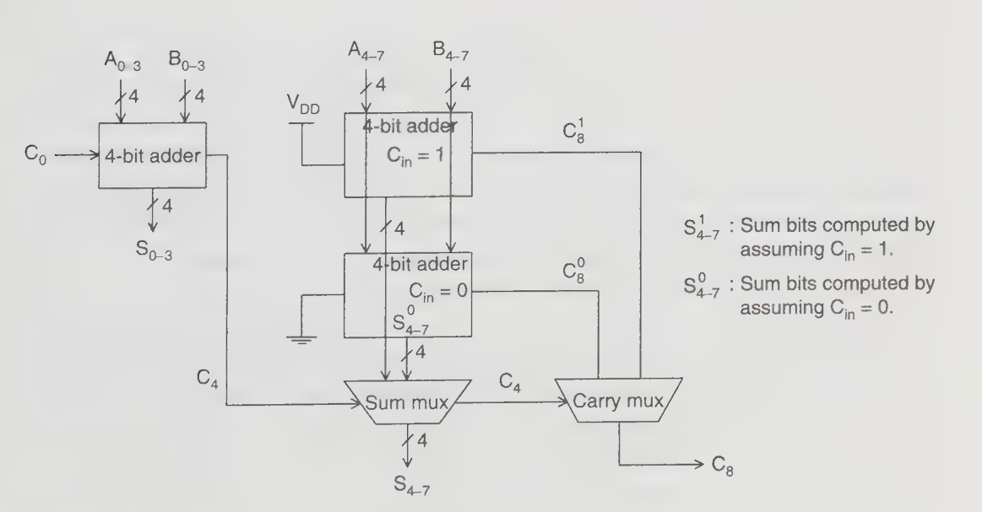
Figure : An 8-bit architecture of CSL

Slide 42
CMOS Adder’s Architectures
Advantages of Carry Select Adders (CSL)
High Speed Operation
Carry Select Adder is faster than the Ripple Carry Adder because it reduces carry propagation delay by computing the sum for both possible carry inputs (0 and 1) simultaneously.
Reduced Carry Delay
Instead of waiting for the carry from the previous stage, CSLA precomputes two possible results and selects the correct one using a multiplexer. This significantly reduces the overall delay.
Suitable for Medium to Large Bit Adders
CSLA is efficient for 16-bit, 32-bit, and larger adders, where Ripple Carry Adders become too slow.

Slide 43
CMOS Adder’s Architectures
Advantages of Carry Select Adders (CSL)
Improved Performance Compared to RCA
Because part of the computation is done in parallel, the addition speed is much higher than Ripple Carry Adder.
Relatively Simple Compared to CLA
The structure of CSLA is simpler than Carry Look Ahead Adder, making it easier to design than CLA while still offering good speed improvement.

Slide 44
CMOS Adder’s Architectures
Disadvantages of Carry Select Adders (CSL)
Large Hardware Requirement
CSLA uses two Ripple Carry Adders for each block (one assuming carry = 0 and another assuming carry = 1), which increases the number of required gates.
Higher Area Consumption
Because of duplicate adders and multiplexers, the circuit occupies more silicon area in VLSI implementations.
Higher Power Consumption
Since two addition operations are performed simultaneously, more switching activity occurs, leading to higher power consumption.

Slide 45
CMOS Adder’s Architectures
Disadvantages of Carry Select Adders (CSL)
Not the Fastest Adder
Although it is faster than RCA, it is still slower than Carry Look Ahead Adders and some advanced adders used in high-performance processors.
Multiplexer Delay
The final output still depends on multiplexer selection, which introduces additional delay.

Slide 46
CMOS Adder’s Architectures
Hybrid Carry Look-Ahead/Carry-Select Adder (Hybrid CLA/CSL):
Hybrid adders, which refer to the elementary combinations of two or more “pure” design methods, aim to reduce power dissipation, improve cost- effectiveness, and achieve other performance enhancements as well.
An example of a hybrid adder that is widely used combines the CLA and CSL and is named the hybrid CLA/CSL.
P_{i}, G_{i}, S_{i}, and C_{i+1} denote the propagate signal, generate signal, sum signal, and carry-out signal for each bit i, respectively, where i = 0, 1,..., 15.
The pair of CSL adder blocks may be based on the MCC adder, which will supply the required generate and propagate signals, G_{i} and P_{i} to the look-ahead carry generator.

Slide 47
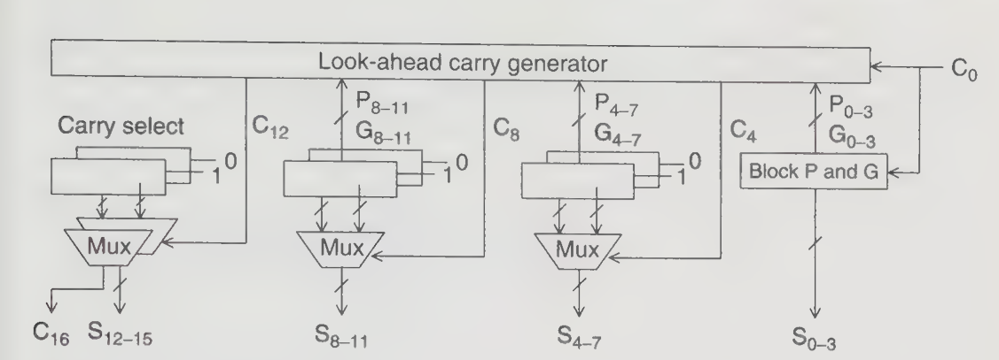
CMOS Adder’s Architectures
Hybrid Carry Look-Ahead/Carry-Select Adder (Hybrid CLA/CSL):
The multiplexers then select the final carry, C₁₆, and also the sum bits when the block carry-in signals are known.
Figure: A 16-bit hybrid CLA/CSL

Slide 48
CMOS Adder’s Architectures
4. Carry Save Adders (CSA)
A Ripple Carry Adder (RCA) uses a chain of cascaded full adders (FAs) to add two binary numbers.
A row of full adders can also be used to reduce three binary numbers into two numbers, instead of directly producing the final sum.
In this approach, the sum bits are produced normally, but the carry bits are not propagated to the next stage immediately.
Instead, the carry bits are saved and added in the next stage, which avoids the delay caused by carry propagation.
This method is called a Carry Save Adder (CSA) because the carries are saved rather than propagated.

Slide 49
CMOS Adder’s Architectures
Carry Save Adders (CSA)
Since the CSA takes three input bits and produces two output bits (sum and carry), it is often referred to as a (3:2) counter.
Unlike RCA, CLA, and CSL adders, the CSA realizes concurrent addition of multiple operands, which is a basic requirement of multiplication.
Instead of using the 2-operand adders that necessitate the time- consuming carry propagation to repeat several times, depending on the number of operands, the CSA’s timing could be improved with a little increase or even a reduction in area.
A CSA tree consists of CSA operators and one adder at the root of the tree.

Slide 50
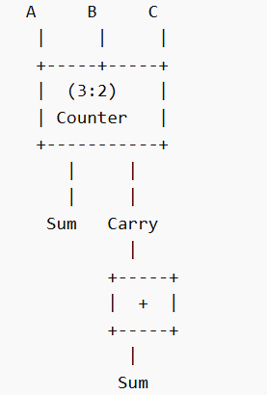
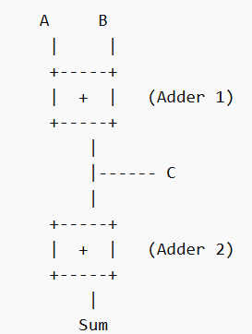
CMOS Adder’s Architectures
Carry Save Adders (CSA)
The CSA operators are used to transform an arbitrary number of operands in the addition process to produce two adding operands, after which the adder at the root of the CSA tree computes the final sum.

Slide 51
CMOS Adder’s Architectures
n-bit Carry Save Adder (CSA)
The 1-bit multi-operand addition using a CSA can be extended to n-bit addition by cascading multiple CSA stages.
An n-bit CSA consists of n independent full adders (FAs) that operate in parallel.
Each full adder receives three input bits of the same position (ith bit) and produces two outputs:
Partial Sum S_{i} and Carry C_{i} .
When more than three operands need to be added, additional CSA stages (levels) are used.
Each new CSA level takes the sum and carry outputs from the previous level, along with another operand, and produces new sum and carry values.​

Slide 52
CMOS Adder’s Architectures
n-bit Carry Save Adder (CSA)
In CSA stages, carry signals are not propagated between adders, which eliminates carry propagation delay.
The carry propagation occurs only in the final stage, where a conventional adder (usually an RCA or CLA) produces the final result.
Therefore, unlike the RCA where delay grows with n full adders, the CSA delay is approximately equal to the delay of one full adder, making it very efficient for multi-operand addition.

Slide 53
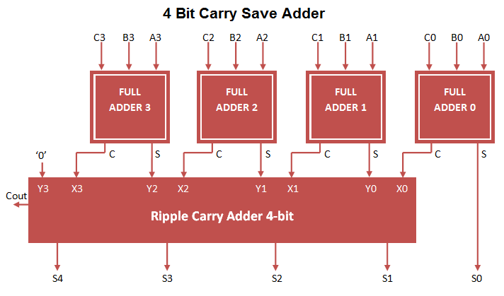
Figure: 4-bit CSA Implementation

Slide 54
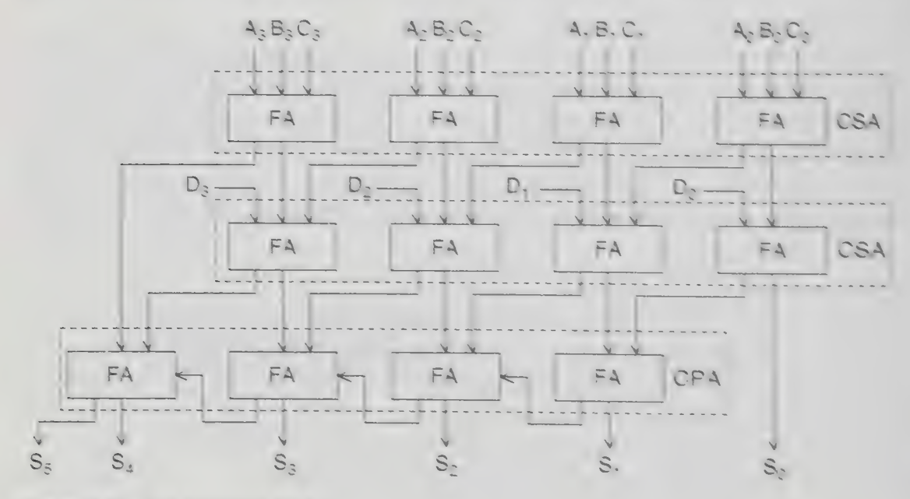
Figure: 4 operand CSA

Slide 55
CMOS Adder’s Architectures
n-bit Carry Save Adder (CSA)
The addition of four 4-bit binary numbers A, B, C and D, with an initial carry-in, C_{o}.
The upper two levels of the FA or (3:2) counters form the 4-bit CSA, while the third level is the 4-bit Carry Propagating Adder (CPA). The CPA used in this case is an RCA, but a CLA or any other fast adder can substitute for it.
Each CSA operator takes three bits of the same significance and then computes the sum of the same significance and the carry for the bit of a higher significance.
The implementation of the CSA can be further expanded to add k operands. Here, (k - 2) CSA levels and one CPA are required to realize the addition operation.

Slide 56
CMOS Adder’s Architectures
n-bit Carry Save Adder (CSA)
The time to obtain the summation is
T =(k - 2) * T_{CSA} + T_{CPA}
where T_{CSA} and T_{CPA}, are the execution times for a CSA level and CPA, respectively.

Slide 57
CMOS Adder’s Architectures
Advantages of Carry Save Adder (CSA)
Very Fast for Multi-Operand Addition
Carry Save Adders are very efficient when adding more than two numbers. They do not propagate the carry immediately, which greatly reduces delay.
No Immediate Carry Propagation
In CSA, the carry is saved and passed to the next stage instead of being propagated through all bits. This reduces the critical path delay.
Parallel Operation
Each bit position is handled independently using full adders operating in parallel, making the addition process faster.

Slide 58
CMOS Adder’s Architectures
Advantages of Carry Save Adder (CSA)
Efficient for Multipliers
Carry Save Adders are widely used in multipliers (such as Wallace Tree and Booth multipliers) where many partial products must be added.
Suitable for High-Speed Arithmetic Units
Because of reduced carry propagation delay, CSAs are suitable for high-speed arithmetic circuits in DSPs and processors.

Slide 59
CMOS Adder’s Architectures
Disadvantages of Carry Save Adder (CSA)
Additional Hardware Requirement
The structure requires extra adders and registers to store the carry and sum separately, increasing hardware complexity.
Increased Area
Due to the additional logic and storage of intermediate carries, the circuit area may increase in VLSI implementation.
Final Stage Delay
Even though intermediate additions are fast, the final stage still requires a carry-propagation adder, which introduces delay.

Slide 60
CMOS Adder’s Architectures
Disadvantages of Carry Save Adder (CSA)
Cannot Produce Final Sum Directly
A CSA produces two outputs: partial sum and carry, not the final result. An additional conventional adder (usually Ripple Carry or CLA) is required to obtain the final sum.
Not Suitable for Two-Operand Addition
If only two numbers need to be added, CSA is not efficient because the extra carry-save logic provides no benefit.

Slide 61
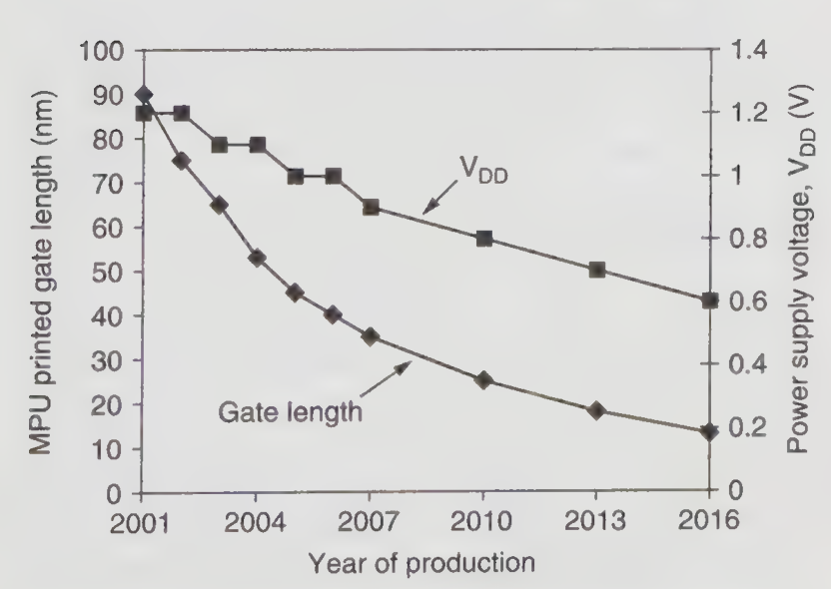
4.4 Low-Voltage Low-Power Design Techniques
Figure: Trends of technology and power supply voltage.

Slide 62
Low-Voltage Low-Power Design Techniques
Trends of technology and power
supply voltage
Most studies on process technologies for low-voltage and low-power applications indicate that scaled CMOS and BiCMOS technologies will continue to be the dominant solutions in the future because of their high performance and efficient power consumption.
Over the years, semiconductor technology has undergone continuous scaling. For example, the technology node was around 95 nm in 2001 and reduced to 65 nm by 2003, showing a rapid decrease in device dimensions.
It was predicted that once manufacturing yield issues are resolved, the gate length could further shrink to about 13 nm by 2016, enabling higher transistor density and improved circuit performance.

Slide 63
Low-Voltage Low-Power Design Techniques
Low-Voltage Low-Power Logic Styles:
Low-power applications have become a major concern for VLSI system designers due to the increasing demand for portable and energy-efficient electronic devices.
In this context, designing high-speed adders with low power consumption has become extremely important because adders are widely used in many critical parts of a processor.
They are essential components of the Arithmetic Logic Unit (ALU), the floating-point unit, and are also used for address generation during cache and memory access operations.
Since these operations occur frequently, the efficiency of the adder directly affects the overall performance and power consumption of the processor.

Slide 64
Low-Voltage Low-Power Design Techniques
Low-Voltage Low-Power Logic Styles:
Therefore, significant efforts are focused on developing adders that dissipate less power while maintaining high speed.
The challenge of reducing power dissipation in adders can be approached at multiple design levels, including architectural level, circuit level, layout level, device level, and process technology level, each contributing to improving the overall efficiency of VLSI systems.
Another potential approach is by implementing a proper choice of logic styles for a given adder type.

Slide 65
Low-Voltage Low-Power Design Techniques
Low-Voltage Low-Power Logic Styles:
Static and dynamic logic styles:
CMOS logic styles are generally classified into static and dynamic logic circuits. In static logic families, the output is continuously determined by the input signals, meaning the output changes immediately whenever there is a change in the inputs.
In contrast, dynamic logic circuits evaluate the output only once during each clock cycle.
Dynamic gates operate using a clock signal and function in two phases: the precharge phase, where the output node is charged to a predefined level, and the evaluation phase, where the output is conditionally discharged based on the input signals.

Slide 66
Low-Voltage Low-Power Design Techniques
Low-Voltage Low-Power Logic Styles:
Static and dynamic logic styles:
Unlike dynamic logic, static logic design does not require a precharge phase, and therefore it avoids the additional switching activity associated with clock-controlled operations.
As a result, static logic circuits generally reduce the extra power dissipation caused by clocking, although dynamic logic can offer advantages in terms of speed and transistor count in certain applications.

Slide 67
Low-Voltage Low-Power Design Techniques
Low-Voltage Low-Power Logic Styles:
XOR/XNOR Gate implementations of different logic styles:
There are five commonly used CMOS logic styles, each with different design characteristics and performance trade-offs.
These include Full Static CMOS, Complementary Pass Transistor Logic (CPL), Double Pass Transistor Logic (DPL), Dual-rail Domino Dynamic Logic, and Single-rail Domino Dynamic Logic.

Slide 68


Low-Voltage Low-Power Design Techniques
CMOS logic styles
When nMOS or pMOS transistors are connected in series, their effective resistance increases, which reduces the current driving capability of the circuit.
To maintain a reasonable conducting current capable of driving capacitive loads, the width of the transistors must be increased.
This is because a series connection of transistors behaves like multiple cascaded resistive devices, which collectively increase the overall resistance of the conduction path.

Slide 69
Low-Voltage Low-Power Design Techniques
The delay time of the circuit is determined by the RC delay, where C represents the capacitance, R represents the resistance, L is the channel length, and W is the channel width.
Since the resistance of a MOS transistor is inversely proportional to its width (W), increasing the transistor width reduces the resistance.
Therefore, to minimize the propagation delay and improve the driving capability of the circuit, the width of the transistors must be increased when multiple devices are connected in series.

Slide 70
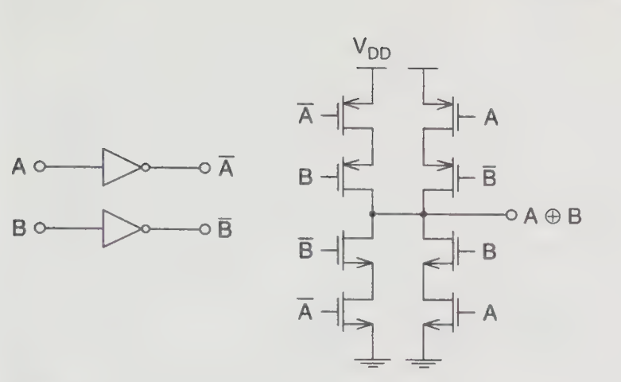
Figure: An XOR gate using full static CMOS.

Slide 71
Low-Voltage Low-Power Design Techniques
CPL:
The major distinction between the pass-transistor logic family and the CMOS logic style is that the source node of the MOS transistor is connected to the input signals rather than to the power supply voltage .
This logic style removes the need for careful sizing of serial transistors and therefore uses only half the number of transistors compared to a full static CMOS XOR gate, making the design more compact and efficient.
However, a limitation occurs in the nMOS pass transistor network.
When the output at node X becomes logically high, the voltage level is not a full supply voltage but approximately V_{DD}-V_{th}, where V_{th} is the threshold voltage of the transistor

Slide 72
Low-Voltage Low-Power Design Techniques
CPL:
Because of this reduced voltage level, the pMOS transistor in the inverter is not completely turned off, which results in a large short-circuit current flowing through the inverter.
To overcome this issue and ensure proper logic levels, an additional pMOS transistor is connected across the inverter output.
This transistor helps pull the output node X up to the full supply voltage V_{DD}, thereby restoring the full logic level and reducing the unwanted short-circuit current.

Slide 73
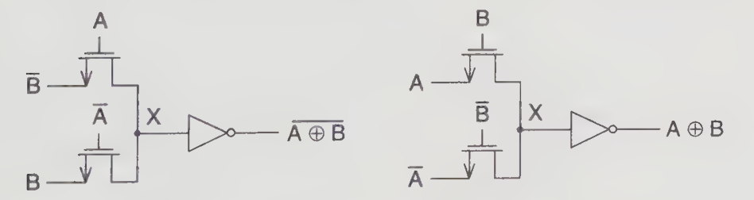
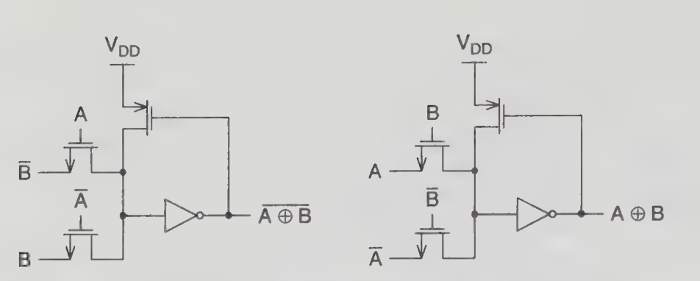
Figure: XOR/XNOR implementation of the CPL
Figure: XOR/XNOR implementation of the CPL with pMOS feedback.

Slide 74
Low-Voltage Low-Power Design Techniques
DPL:
Another pass-transistor-based logic design is Double Pass Transistor Logic (DPL), which can be considered an improvement or modification of Complementary Pass Transistor Logic (CPL).
The XOR/XNOR gate implemented using DPL employs both nMOS and pMOS transistors in the pass network. In CPL designs, only nMOS pass transistors are typically used, which leads to a threshold voltage drop problem when a logic high is transmitted, resulting in a reduced output voltage level.
However, in DPL, the use of both nMOS and pMOS devices allows the circuit to pass both logic ‘1’ and logic ‘0’ more effectively, thereby maintaining full voltage swing.
As a result, DPL overcomes the threshold voltage loss associated with CPL, improving signal integrity and overall circuit performance.

Slide 75
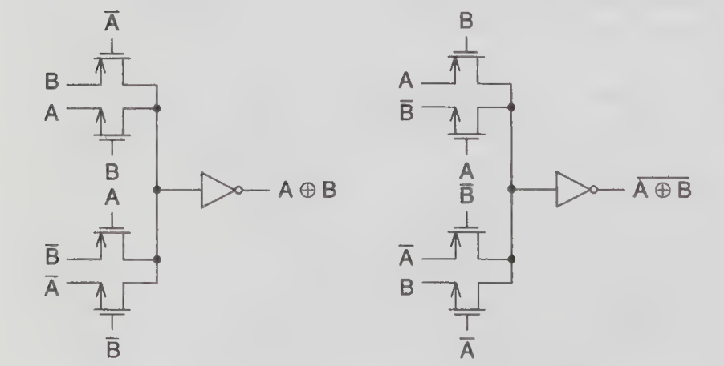
Figure: XOR/XNOR using DPL

Slide 76
Low-Voltage Low-Power Design Techniques
Dual-rail Domino logic style :
Unlike static logic techniques, dynamic logic design operates in two phases: precharge and evaluation. The precharge phase occurs when the clock (CLK) signal is low, during which the output node is charged to a predefined level.
The evaluation phase occurs when the clock signal becomes high, allowing the circuit to evaluate the logic function based on the input signals.
Because of these controlled phases, dynamic logic reduces spurious or unnecessary switching transitions, which are commonly present in static logic circuits and contribute to extra power dissipation.
However, dynamic logic requires additional components such as clock drivers, which themselves consume power and may increase the overall power dissipation.

Slide 77
Low-Voltage Low-Power Design Techniques
Dual-rail Domino logic style :
According to reported studies, dual-rail inputs are mainly required for implementing XOR/XNOR gates, while other logic functions such as NAND and NOR gates can be implemented using single-rail inputs.
Using single-rail inputs reduces circuit complexity and helps lower power consumption.
An example of this approach is the NOR gate implemented using single-rail Domino logic, where dynamic operation improves performance while minimizing power dissipation.

Slide 78
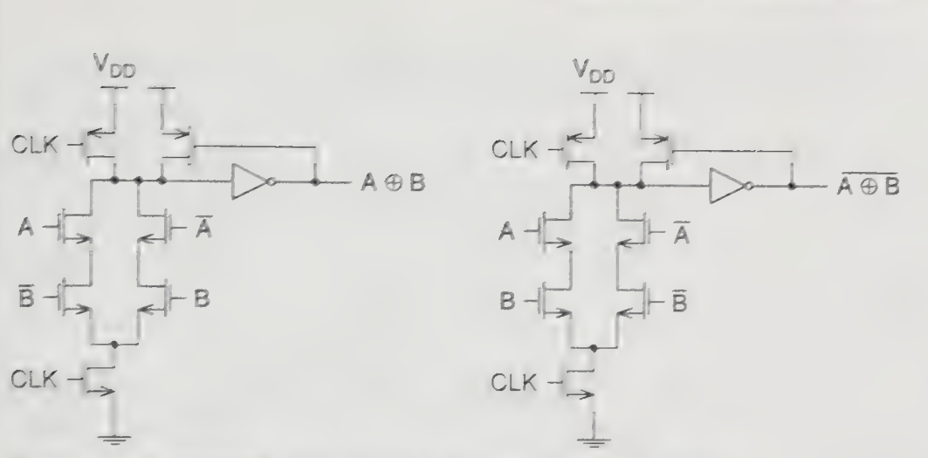
Figure: XOR/XNOR gate using dual-rail Domino logic style

Slide 79
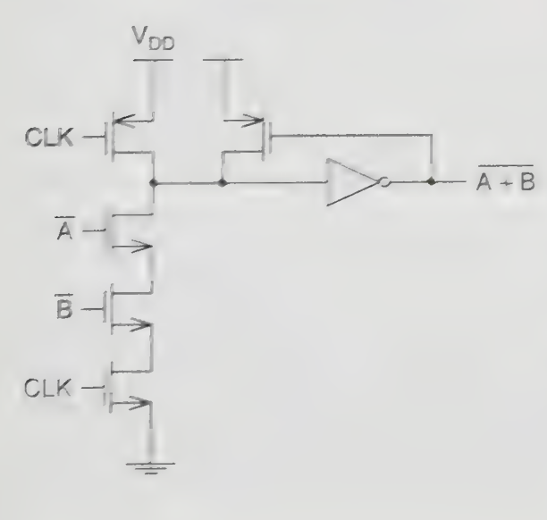
Figure: NOR gate realization using single-rail Domino logic style

Slide 80
4.5 Overview of Multiplication
Multiplication can be considered as a series of repeated additions.
The number to be added is called the multiplicand, the number of times it is added is called the multiplier, and the result obtained is called the product.
The basic operations involved in multiplication include generating and accumulating or adding the partial products.
Consequently, to speed up the entire multiplication process, these two major steps must be optimized.
The two main categories of binary arithmetic multiplication involve computing unsigned numbers and computing signed numbers.

Slide 81
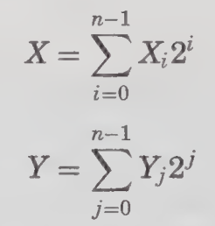
Overview of Multiplication
Unsigned multiplication:
Real-time computer applications require fast multiplication.
By utilizing AND gates and full adders,multiplication can be implemented on the processor much in the same way as it is done by hand: multiply each digit of the multiplier by the multiplicand, thereby generating partial products and then sum up the respective partial products in order to generate the final result.
Assume that X and Y are two n-bit unsigned numbers, where X is the multiplicand and Y is the multiplier. They can be expressed as follows :

Slide 82
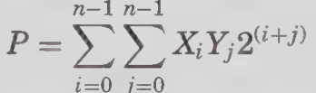
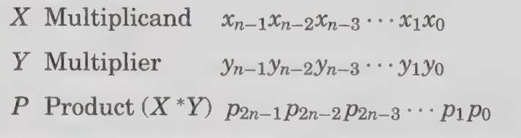
Overview of Multiplication
Unsigned multiplication:
The product of X and Y is P and it can be written in the following form:
To illustrate further, the multiplicand X and multiplier Y can be represented as follows:
Each of the partial product terms Pn = XiYj is called the summand.

Slide 83
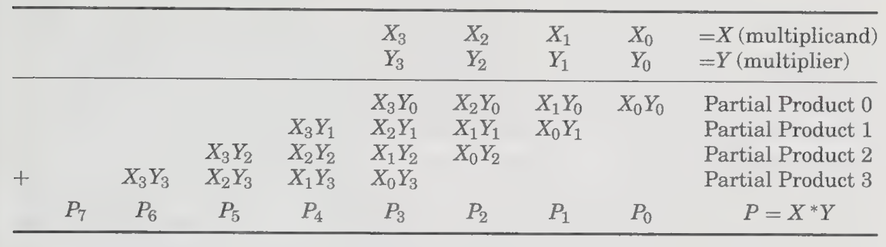
TABLE: General Multiplication Algorithm

Slide 84
Overview of Multiplication
Shift/add multiplication algorithms:
Sequential (1-bit-at-a-time) multiplication is performed by initializing the cumulative partial product to 0.
The algorithm successively adds shifted versions of the multiplicand to the cumulative partial product.
Each successive term to be added is shifted by one bit relative to the previous term.
Instead of shifting the multiplicand repeatedly, a simpler method is to shift the cumulative partial product to align it with the next partial product.
Two versions of the algorithm exist depending on the order in which partial products are processed:
Top-to-bottom processing
Bottom-to-top processing

Slide 85
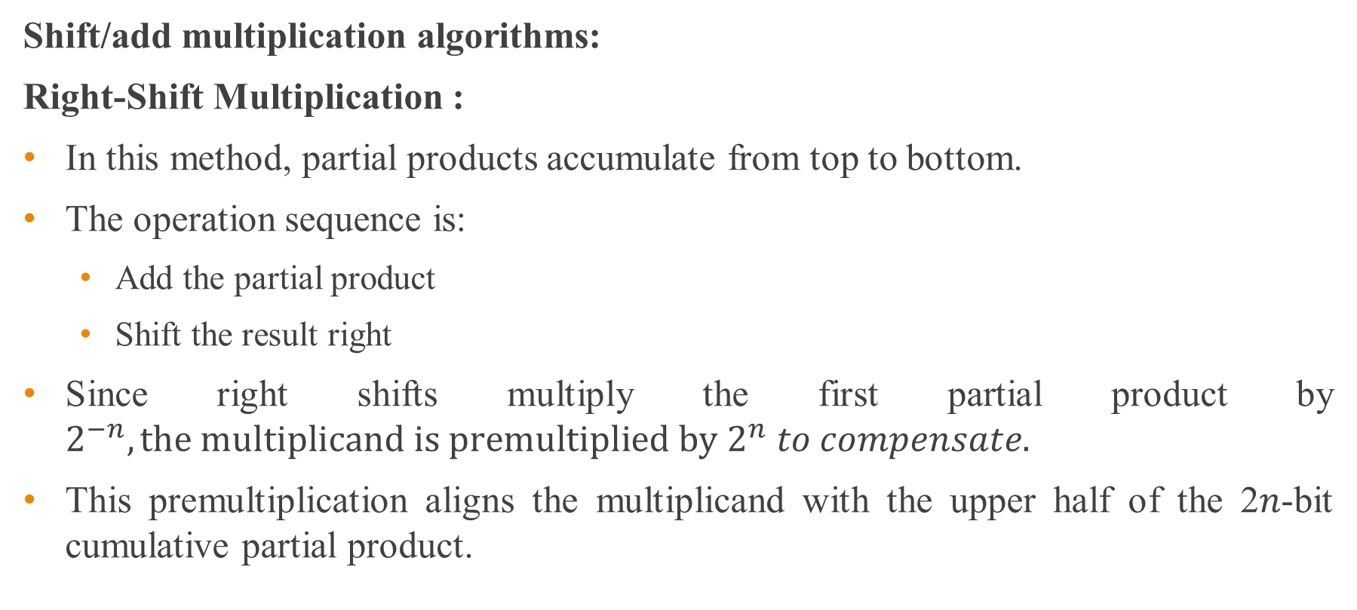
Overview of Multiplication
Shift/add multiplication algorithms:
Right-Shift Multiplication :
In this method, partial products accumulate from top to bottom.
The operation sequence is:
Add the partial product
Shift the result right
Since right shifts multiply the first partial product by $2^{−n}, the multiplicand is premultiplied by$ $2^{n} to compensate.$
This premultiplication aligns the multiplicand with the upper half of the 2𝑛-bit cumulative partial product.

Slide 86
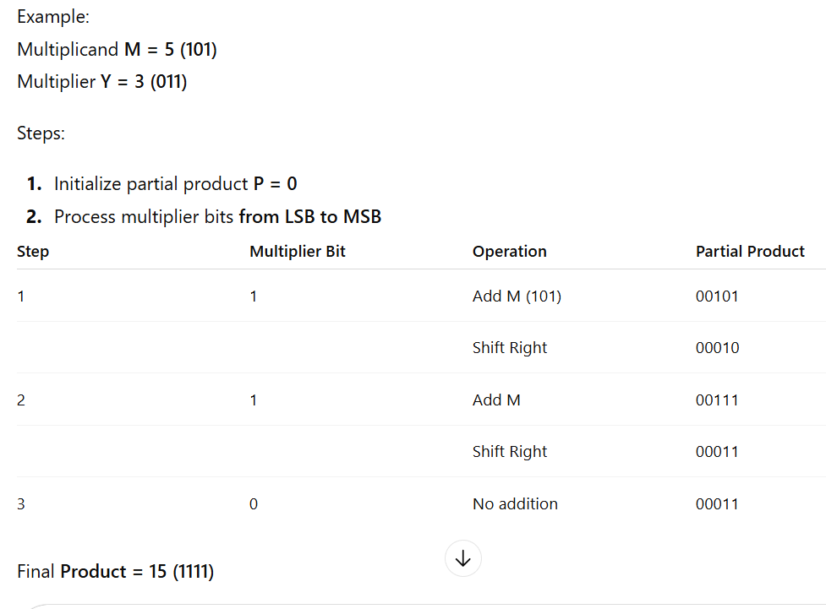
Shift/add multiplication algorithms:
Right-Shift Multiplication Example (Top → Bottom):

Slide 87
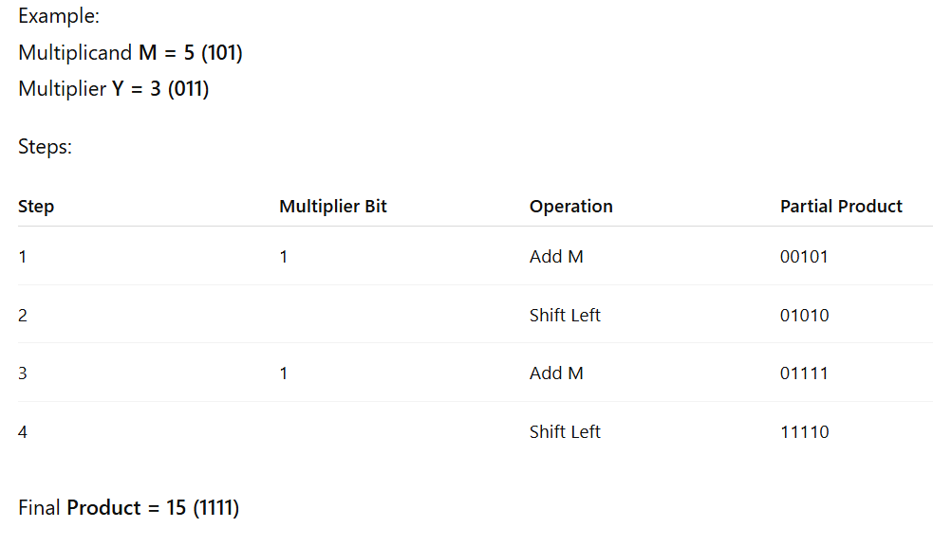
Shift/add multiplication algorithms:
Left-Shift Multiplication Example (Top → Bottom):

Slide 88
Overview of Multiplication
Shift/add multiplication algorithms:
Left-Shift Multiplication :
In this method, partial products accumulate from bottom to top.
The operation sequence is:
Shift the cumulative product left
Add the partial product
This approach naturally aligns the partial products without requiring premultiplication.

Slide 89


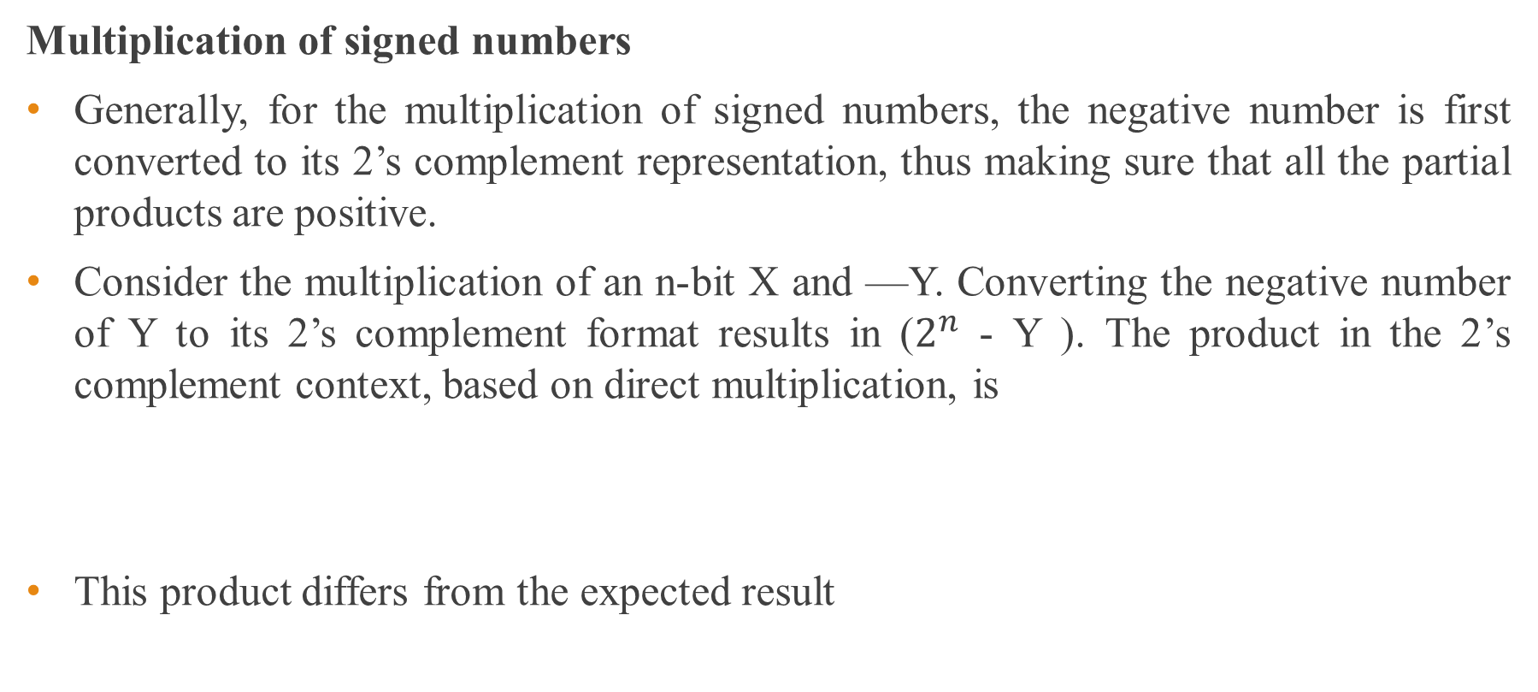
Overview of Multiplication
Multiplication of signed numbers
Generally, for the multiplication of signed numbers, the negative number is first converted to its 2’s complement representation, thus making sure that all the partial products are positive.
Consider the multiplication of an n-bit X and —Y. Converting the negative number of Y to its 2’s complement format results in ($2^{n}$ - Y ). The product in the 2’s complement context, based on direct multiplication, is
This product differs from the expected result

Slide 90

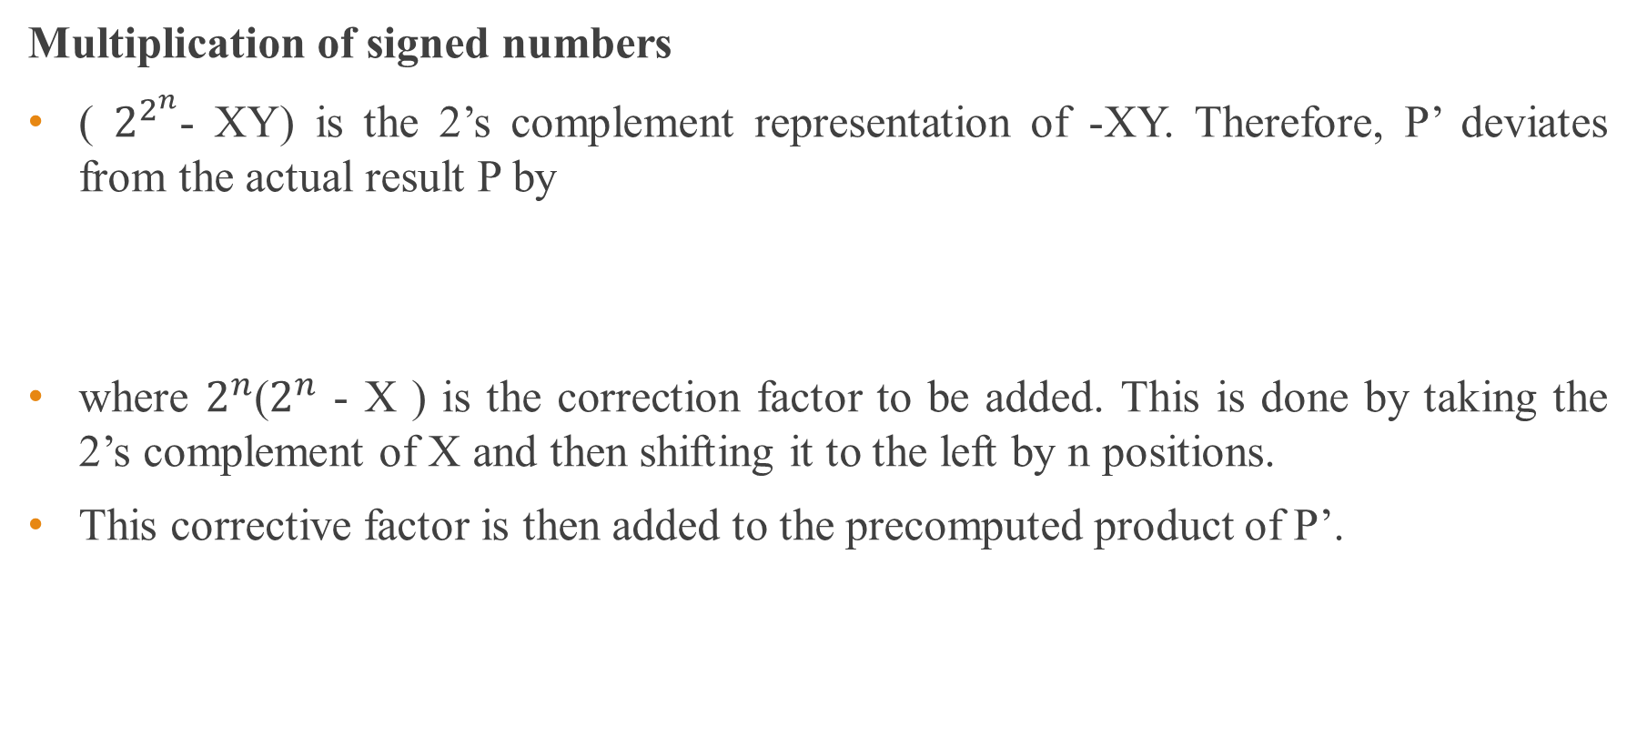
Overview of Multiplication
Multiplication of signed numbers
( $2^{2^{n}}$- XY) is the 2’s complement representation of -XY. Therefore, P’ deviates from the actual result P by
where $2^{n}$($2^{n}$ - X ) is the correction factor to be added. This is done by taking the 2’s complement of X and then shifting it to the left by n positions.
This corrective factor is then added to the precomputed product of P’.

Slide 91
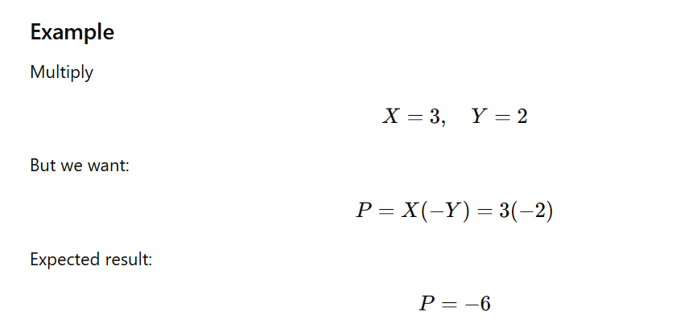

Slide 92
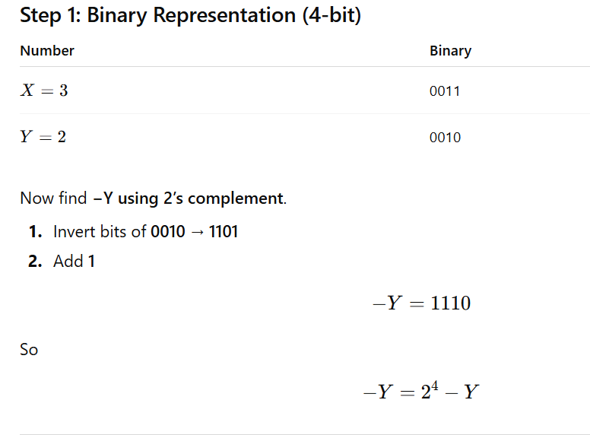

Slide 93
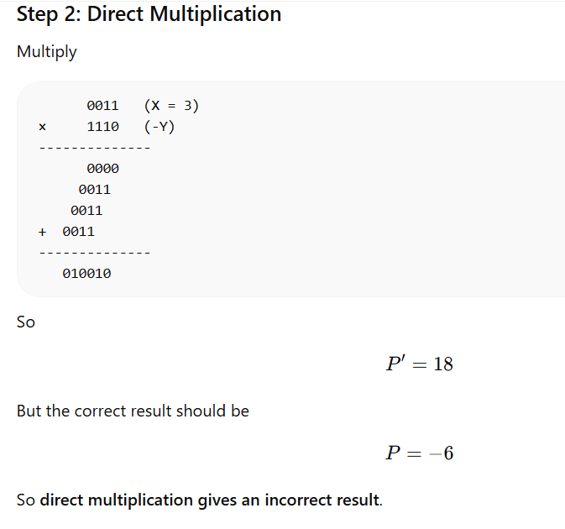

Slide 94
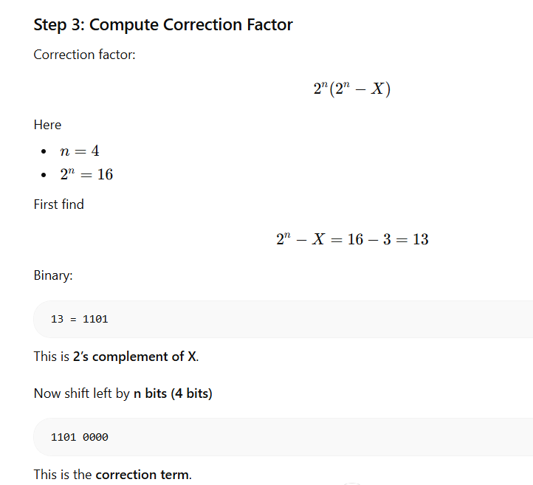

Slide 95
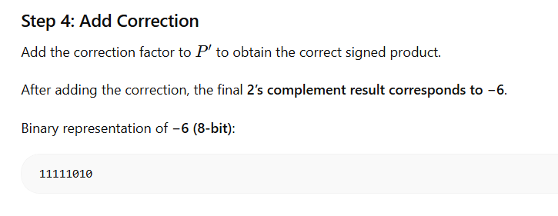

Slide 96
4.6 Types of Multiplier Architectures
The multiplier architecture can be generally classified into the following categories: serial, parallel, and serial-parallel.
Serial multipliers :
The serial multiplier uses a successive addition algorithm. They are simple in structure because both the operands are entered in a serial manner.
Therefore, the physical circuit requires less hardware and a minimum amount of chip area.
However, the speed performance of the serial multiplier is poor due to the operands being entered sequentially.

Slide 97
Types of Multiplier Architectures
Parallel multipliers:
Three important criteria considered in the design of multipliers are chip area, computation speed, and power dissipation.
Modern digital systems require high-speed arithmetic operations, and therefore many systems incorporate parallel multiplication units. In microprocessors, multipliers are used in the Arithmetic Logic Unit (ALU) to perform arithmetic computations efficiently.
Similarly, Digital Signal Processing (DSP) systems rely heavily on multipliers to implement algorithms such as convolution, filtering, and other signal processing operations.

Slide 98
Types of Multiplier Architectures
Parallel multipliers:
Today, high-speed parallel multipliers with larger hardware resources and greater complexity are widely used in Reduced Instruction Set Computers (RISC), DSP processors, and graphics accelerators.
Common examples of parallel multipliers include array multipliers, such as the Braun multiplier and Baugh–Wooley multiplier, and tree multipliers, such as the Wallace multiplier.
Array multipliers have a regular and structured layout, which makes them easier to implement in hardware, whereas tree multipliers are generally faster because they reduce the number of addition stages.

Slide 99
Types of Multiplier Architectures
Parallel multipliers:
However, the main disadvantage of these parallel multipliers is their large chip area requirement.
Although they provide high-speed performance, they are relatively expensive in terms of silicon area and power consumption.
This is because both operands are applied to the multiplier in parallel, which requires more hardware resources and increases circuit complexity when compared to serial multipliers, where operations are performed sequentially.

Slide 100
Types of Multiplier Architectures
Serial-Parallel multipliers:
The serial-parallel multiplier serves as a good trade-off between the time-consuming serial multiplier and the area-consuming parallel multipliers.
These multipliers are used when there is a demand for both high speed and small area.
In a device using the serial-parallel multiplier, one operand is entered serially and the other is stored in parallel with a fixed number of bits.
The resultant enhancement in the processing speed and the chip area will become more significant when a large number of independent operations are performed.

Slide 101
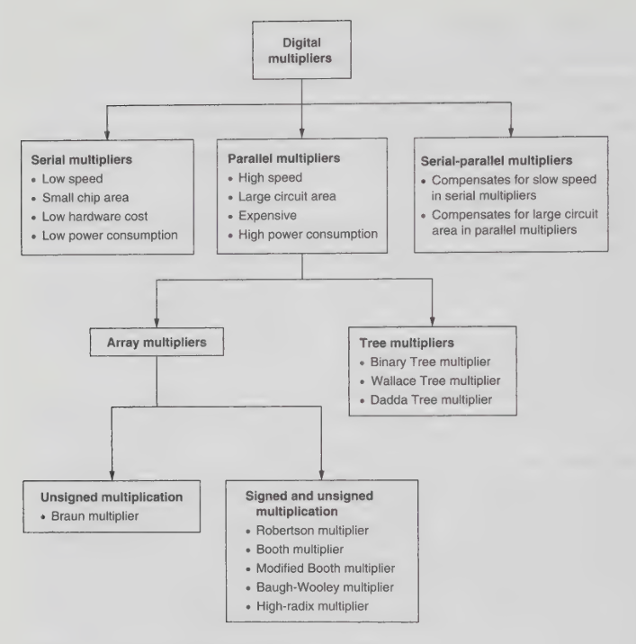

Slide 102
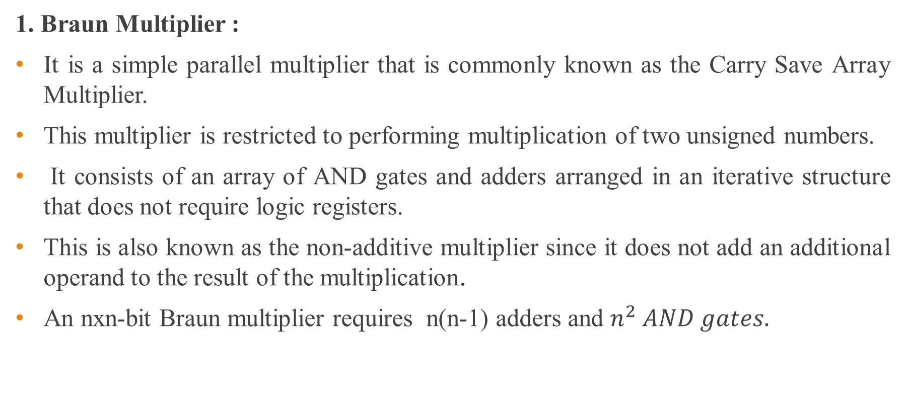
Types of Multiplier Architectures
1. Braun Multiplier :
It is a simple parallel multiplier that is commonly known as the Carry Save Array Multiplier.
This multiplier is restricted to performing multiplication of two unsigned numbers.
It consists of an array of AND gates and adders arranged in an iterative structure that does not require logic registers.
This is also known as the non-additive multiplier since it does not add an additional operand to the result of the multiplication.
An nxn-bit Braun multiplier requires n(n-1) adders and $n^{2} AND gates.$

Slide 103
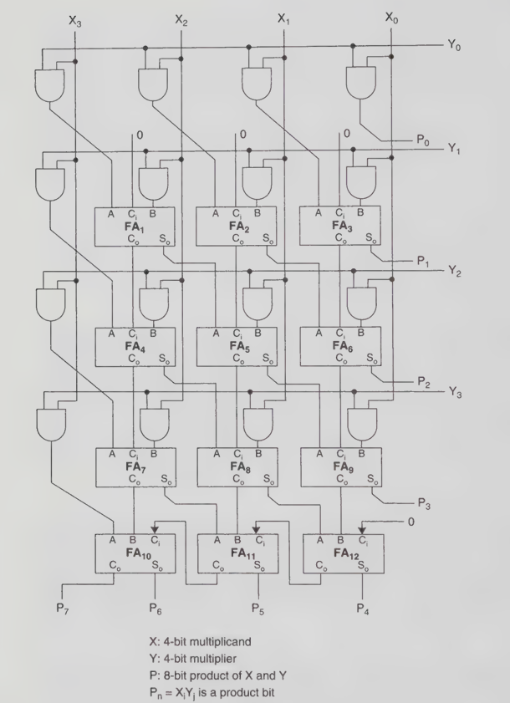

Slide 104
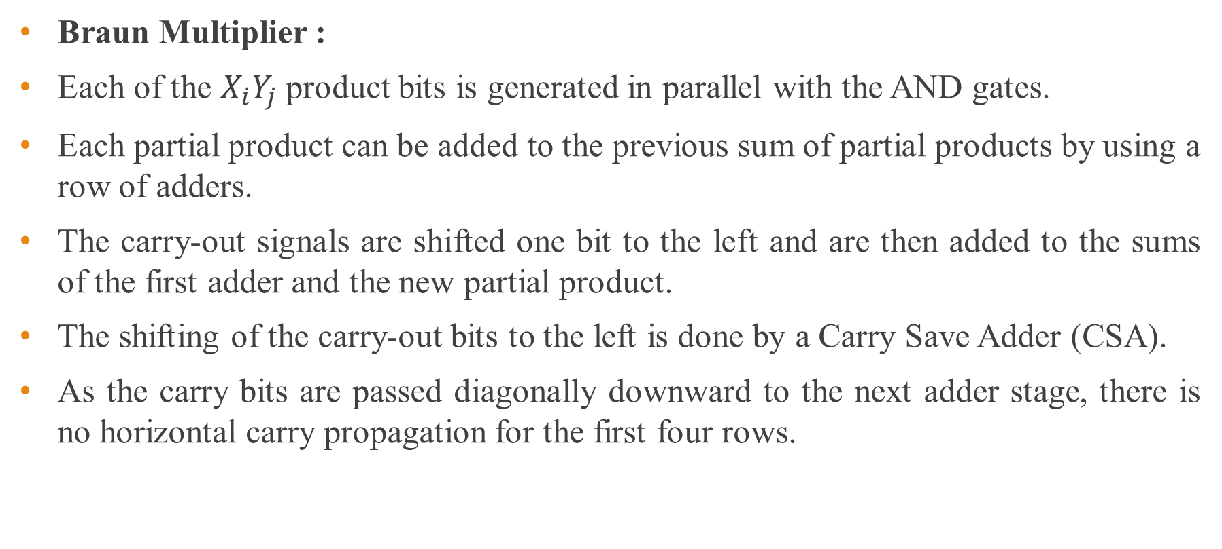
Types of Multiplier Architectures
Braun Multiplier :
Each of the $X_{i}Y_{j}$ product bits is generated in parallel with the AND gates.
Each partial product can be added to the previous sum of partial products by using a row of adders.
The carry-out signals are shifted one bit to the left and are then added to the sums of the first adder and the new partial product.
The shifting of the carry-out bits to the left is done by a Carry Save Adder (CSA).
As the carry bits are passed diagonally downward to the next adder stage, there is no horizontal carry propagation for the first four rows.

Slide 105
Types of Multiplier Architectures
Braun Multiplier :
Instead, the respective carry bit is “saved” for the subsequent adder stage. Ripple Carry Adders (RCA) are used at the final stage of the array to output the final result.
Performance of Braun Multiplier:
The Braun multiplier provides good performance for multiplying unsigned operands smaller than 16 bits in terms of speed, power consumption, and area efficiency.
It has a simple and regular array structure, which makes its hardware implementation easier compared to many other multiplier architectures

Slide 106
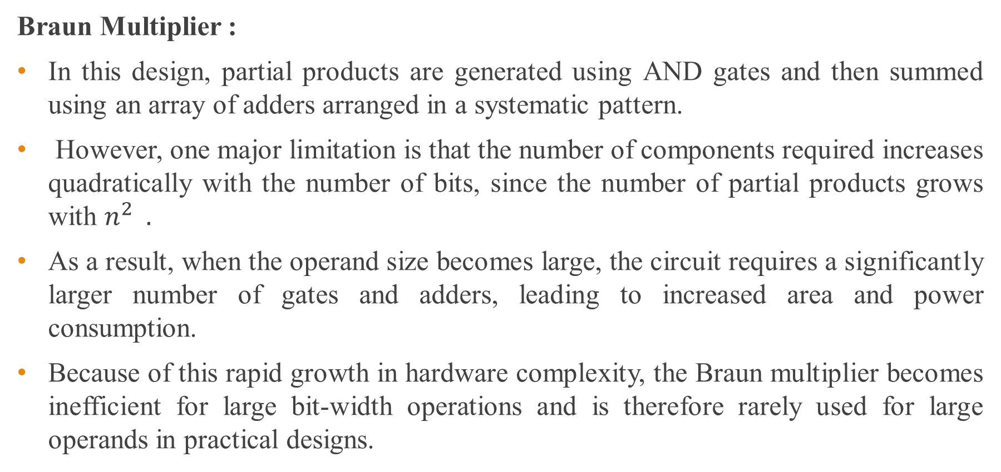
Types of Multiplier Architectures
Braun Multiplier :
In this design, partial products are generated using AND gates and then summed using an array of adders arranged in a systematic pattern.
However, one major limitation is that the number of components required increases quadratically with the number of bits, since the number of partial products grows with $n^{2} .$
As a result, when the operand size becomes large, the circuit requires a significantly larger number of gates and adders, leading to increased area and power consumption.
Because of this rapid growth in hardware complexity, the Braun multiplier becomes inefficient for large bit-width operations and is therefore rarely used for large operands in practical designs.

Slide 107
Types of Multiplier Architectures
Braun Multiplier :
Another drawback of the Braun multiplier is its susceptibility to glitching problems, particularly at the final stage of the full adders.
This occurs because the design relies on Ripple Carry Adders (RCA), where the carry signal propagates sequentially from one stage to the next, causing temporary signal transitions before the final output stabilizes.
These glitches can lead to additional power dissipation and timing issues, which further reduces the efficiency of the Braun multiplier in high-performance systems.

Slide 108
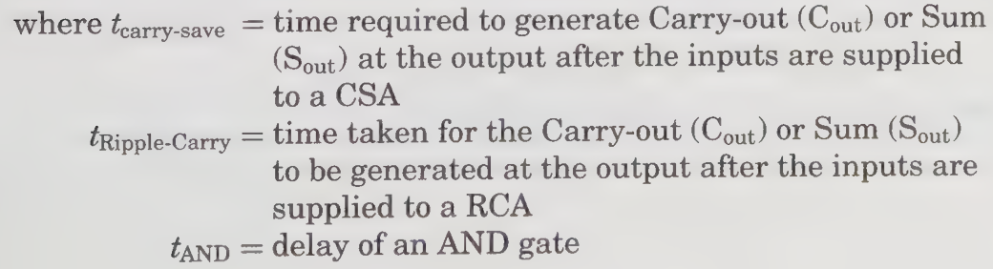
Types of Multiplier Architectures
Braun Multiplier :
The worst-case multiplication time of a Braun multiplier can be expressed as :

Slide 109
Types of Multiplier Architectures
Braun Multiplier :
Advantages:
Simple and regular array structure, easy to design and implement in VLSI
Suitable for unsigned multiplication
Good performance (speed, power, area) for small bit sizes (<16 bits)
Easy layout due to repetitive structure
Disadvantages:
Hardware complexity increases quadratically (n²) with bit size
Not efficient for large operands
High area and power consumption for large multipliers
Uses Ripple Carry Adders, leading to slow carry propagation
Prone to glitching problems, causing extra power consumption

Slide 110
Types of Multiplier Architectures
2. Baugh-Wooley Multiplier:
The Baugh-Wooley multiplier is an enhanced version of the Braun multiplier.
It is designed to cater to multiplication of both signed and unsigned operands, which are represented in the 2’s complement number system.
The Baugh–Wooley multiplier architecture is based on the carry-save addition algorithm, which allows efficient addition of partial products.
It maintains a regular and repetitive array structure, similar to the array multiplier, making it suitable for VLSI implementation.
This design is particularly useful for performing signed multiplication using two’s complement numbers.

Slide 111


Slide 112


Slide 113


Slide 114

The five basic building blocks of the Baugh-Wooley multiplier.

Slide 115



Slide 116

Types of Multiplier Architectures
Baugh-Wooley Multiplier:
The Baugh–Wooley multiplier operates on signed operands represented in 2’s complement form and rearranges the partial products so that they appear as positive values.
This approach simplifies the hardware implementation of signed multiplication while maintaining a regular array structure. The numerical values of the 2’s complement numbers X and Y can therefore be expressed using the following representation.

Slide 117

Types of Multiplier Architectures
Baugh-Wooley Multiplier:
The product of X and Y is expressed as :
It is observed that the last two terms of are subtracted from the partial product.

Slide 118

Types of Multiplier Architectures
Baugh-Wooley Multiplier:
To prevent the use of subtractor cells and use only adders, these negative terms should be transformed.
Therefore,

Slide 119

Types of Multiplier Architectures
Baugh-Wooley Multiplier:
The product P becomes

Slide 120

Types of Multiplier Architectures
Baugh-Wooley Multiplier:
The Baugh–Wooley multiplier is used for signed multiplication in 2’s complement form.
It converts negative partial products into positive form.
This enables a regular array structure, suitable for VLSI implementation.

Slide 121




Types of Multiplier Architectures
Baugh-Wooley Multiplier:
Basic Concept Handling Signed Numbers
Partial Products Modified Partial Products

Slide 122



Types of Multiplier Architectures
Baugh-Wooley Multiplier:
Column-wise Addition Handling Signed Numbers
Hardware Requirement Advantages

Slide 123
Types of Multiplier Architectures
Baugh-Wooley Multiplier:
Performance Consideration:
The area and power consumption of multiplier architectures depend on:
Number of bits in the operands
Choice of multiplier structure
Layout strategy used
As the operand size increases, both:
Silicon area
Power consumption also increase

Slide 124
Types of Multiplier Architectures
Baugh-Wooley Multiplier:
Performance Consideration:
Regular and local structures (like array multipliers):
Improve layout efficiency
Reduce interconnect complexity
Increased regularity and locality at the silicon level:
Minimizes wiring overhead
Reduces switching activity
Leads to lower power consumption
In standard-cell-based design flow, such structures are:
Easier to implement
More power-efficient

Slide 125
Types of Multiplier Architectures
Baugh-Wooley Multiplier :
Advantages:
Efficient for signed multiplication using 2’s complement representation
Maintains a regular and uniform array structure, suitable for VLSI design
Avoids explicit sign handling, simplifying hardware implementation
Compatible with carry-save addition, improving speed compared to simple array multipliers
Disadvantages:
Still has high hardware complexity (n² growth) similar to array multipliers
Requires more adders due to sign correction terms
Increased circuit complexity compared to unsigned multipliers
Not as fast as advanced multipliers like Wallace tree or Booth multipliers for large bit sizes
Higher power and area for large operand sizes

Slide 126
Types of Multiplier Architectures
3. Booth Multiplier:
Area-efficient and fast multipliers are the essential blocks for high- performance computing.
Therefore, multipliers should be small enough so that a larger number of them may be integrated on a single chip.
Conventional array multipliers, like the Braun multiplier and the Baugh-Wooley multiplier, achieve comparatively good performance, but they require large areas of silicon, unlike the add-shift algorithms, which require less hardware and exhibit poorer performance.

Slide 127
Types of Multiplier Architectures
Booth Multiplier:
The Booth multiplier makes use of the Booth encoding algorithm in order to reduce the number of partial products by considering two bits of the multiplier at a time, thereby achieving a speed advantage over other multiplier architectures.
This algorithm is valid for both signed and unsigned operands.

Slide 128


Slide 129


Slide 130


Slide 131




Registers Used:
Decision Step:
Initialization:
Shift Operation:

Slide 132


Counter Update:
Final Output:

Slide 133
Types of Multiplier Architectures
Booths Multiplier :
Advantages:
Efficient for signed (2’s complement) multiplication
Reduces number of addition/subtraction operations
Handles consecutive 1’s efficiently (bit-pair recoding)
Saves hardware resources compared to basic array multipliers
Suitable for high-speed multiplication
Widely used in modern processors and DSP systems

Slide 134
Types of Multiplier Architectures
Booths Multiplier :
Disadvantages:
Control logic is complex compared to simple multipliers
Requires additional components like:
Extra bit Q₋₁
Decision-making circuitry
Performance may degrade when:
Multiplier has alternating bits (e.g., 101010)
Requires arithmetic shift operations, increasing design complexity
Slightly higher power consumption due to control overhead

Slide 135
Types of Multiplier Architectures
4. Introduction to WallaceTree Multiplier.
Booth’s algorithm reduces the number of partial products approximately by half, making it efficient for signed multiplication.
However, as the operand size increases (such as 32-bit and above), the generated partial products become significantly wider, leading to increased complexity and delay.
This results in performance degradation in large multipliers, even when using modified Booth techniques.
In contrast, the Wallace tree multiplier improves performance by reducing partial products more efficiently using multi-input compressors, which allow several partial products to be added simultaneously.
This parallel reduction significantly enhances speed and makes the Wallace tree more suitable for high-bit-width multiplication.

Slide 136

Types of Multiplier Architectures
Introduction to WallaceTree Multiplier.
The Wallace tree multiplication algorithm utilizes pseudo adders (carry-save adders) that take three input bits and produce two output bits whose combined value equals the sum of the inputs.
The key advantage of these pseudo adders is that they eliminate carry propagation during intermediate stages, significantly increasing the speed of multiplication.
By using multiple pseudo adders in parallel, the Wallace tree efficiently reduces partial products, resulting in an overall delay approximately proportional to $\log_{2}n$, where $n$is the number of partial product rows.
However, the main drawback of the Wallace tree architecture is its irregular layout, caused by complex interconnections between components, making it less suitable for regular VLSI design compared to array-based multipliers.

Slide 137
Types of Multiplier Architectures
Introduction to WallaceTree Multiplier.
Process:
In general, the Wallace tree multiplication process begins by generating partial products, which are then reduced using a set of counters (carry-save adders) that combine multiple inputs without propagating carries.
This produces an intermediate matrix consisting of sum and carry outputs. In subsequent stages, additional counters further reduce this matrix in parallel until only two rows remain.
Finally, these two rows are added using a carry propagate adder to obtain the final product.
By postponing carry propagation until the last stage, this approach significantly improves speed, and the overall performance depends on the number of reduction levels in the tree.

Slide 138
Types of Multiplier Architectures
Introduction to WallaceTree Multiplier.
4:2 compressors :
The primary advantage of tree multipliers is that their speed improves logarithmically with respect to the operand length, unlike iterative array multipliers where the delay increases linearly with operand size.
This makes tree-based architectures significantly faster for large-bit multiplications.
Additionally, the use of 4:2 compressors enhances design efficiency by reducing four input bits of the same weight into two outputs, resulting in a more regular and structured layout compared to traditional 3:2 counters.
This improved regularity helps in achieving better performance and easier implementation in high-speed multiplier designs.

Slide 139


Slide 140



Types of Multiplier Architectures
Introduction to WallaceTree Multiplier.
The Wallace tree multiplier achieves high-speed operation by reducing partial products in parallel using carry-save adders and compressors such as the 4:2 compressor. For a 4:2 compressor, the sum output is given by
which can be rearranged as
to reduce delay. The carry outputs C and C_{out} are generated without full carry propagation, since C_{in} and C_{out} have the same weight and are independent.
This carry-save mechanism avoids propagation delays in intermediate stages, resulting in an overall delay proportional to O($\log_{2}^{n}$) .

Slide 141
Types of Multiplier Architectures
Introduction to WallaceTree Multiplier.
By minimizing the critical path and limiting carry propagation to the final stage, the Wallace tree multiplier provides significantly faster performance, especially for large operand sizes.

Slide 142

Figure: Wallace Tree Multiplier using full and half adders

Slide 143

Types of Multiplier Architectures
Advantages:

Slide 144

Types of Multiplier Architectures
Disadvantages:

Slide 145
Thank You

